Slide 1
Electronic Research Application Portal (eRAP) Town Hall eRAP Core Team:
James “Chip” Masters
Alona Rabin
Donald Louie
November 2024
Notes:
Welcome to eRAP Town hall

Slide 2



Meet the eRAP Core team
James “Chip” Masters
Director for Research Data Services
Alona Rabin
eRAP Product Owner and Project Lead
Donald Louie
Programmer Analyst

Slide 3
Agenda
eRAP to Date: Usage, Support, and Maintenance
  Usage and Login Statistics from March 2024 - Oct 2024
  Support Desk Statistics
  Active Projects for 2024
  New Users
  Accomplishments
Looking Forward: eRAP 2.0 Demo
  Implementing features for eRAP 2.0 Minimum Viable Product (MVP) version
  User testing and acceptance
  Projects onboarding
  What We’re Asking of the eRAP Principal Investigators (PIs) and Projects
Project Maintenance for 2025

Slide 4
eRAP to Date: Usage, Support, and Maintenance

Slide 5
eRAP User Logins from Oct 2023 – Oct 2024
708,000 total logins (October 2023 to October 2024)
Number of User Logins
2023
2024
Month
Notes:
Which shows the large number of users.

Slide 6
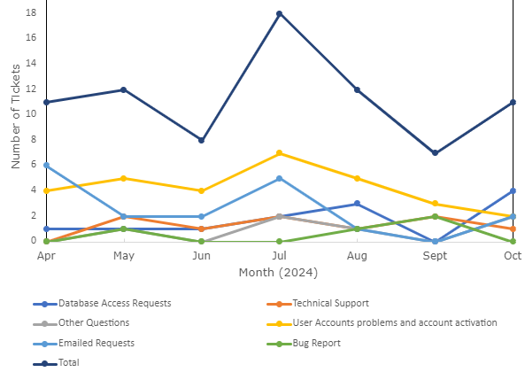
Ticket Breakdown by Type, Apr 2024 − Oct 2024
Highest number of tickets was in Jul 2024; lowest was in Sept 2024
User account problems and account activation was the most prevalent issue
18
12
12
11
11
Ticket type definitions:
Database Access Requests
Technical Support
Other Questions
User Accounts problems and account activation
Emailed Requests
Bug Report
8
7
Notes:
--Highest number of tickets was in July 2024 was due to the fact of user activation and the time frame for user login back
--Self support administrators leave the team and not assigning new admin

Slide 7
eRAP Project stats for Mar 2024 - Oct 2024
26 Unique Principal Investigators
53 Active projects
119 New users
Accomplishments
Upgraded eRAP to support Freezerworks 2022
Updated servers with newer operating system to enhanced security
Worked with DTP on a security scan
Produced the Minimum Viable Product of eRAP 2.0
Fix the issue with account deactivation by giving users more time between login after activation

Slide 8
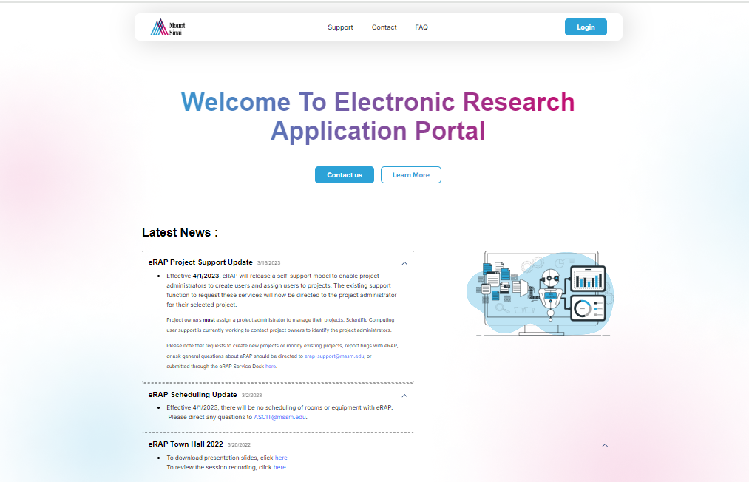
Looking Forward: eRAP 2.0

Slide 9
  eRAP 2.0 Features MVP version
Login process | Ability to select sub-record
Security per user and project (actions can or can't be done by the user in the portal) | Ability to navigate and view data between parent and sub-levels
Applications layout | Ability to deactivate parent-level and sub-level
Project selection | File Upload and download functionality
Dynamic search per project | Left navigation actions (items that users can perform)
Dynamic Search results | Utilities –set user-defined field functionality if the user has the rights
Smart search on results | Structured Query Language -> Reporting server(SSRS)
Epic Demographics search by Medical Record Number | Luck and Unlock record
View Record data | Link and Save
Edit Record data | Navigation to portal admin
Save Record data | Audit functionality for user actions and metadata changes
Ability to view sub-levels

Slide 10
Demo of eRAP 2.0 Current Status
Notes:
https://erap-staging.mssm.edu:9043/

Slide 11
Project Timeline 2024/2025
User Acceptance Testing (UAT)
& Sign Off
Project Migration to eRAP
Nov/Dec 2024
January − June 2025
November 11, 2024: Identify 1 project representative for user testing
November 13, 2024: Launch user testing
Plan for 3-5 days for each round of user testing
Allow 3 days between rounds to fix any issues
All testing and user sign off must be completed by December 20, 2024
NOTE: Legacy eRAP will continue to function during the migration
January 1 − February 1, 2025:
eRAP Core Team to:
Review testers’ feedback
Identify any changes needed prior to onboarding
Deploy eRAP 2.0 on the Production servers prior to commencing the transition
Project representatives are:
Encouraged to attend training, sessions prior to migration
Coordinate with the Core Team to schedule their project migration to eRAP 2.0
January 1 − June 30, 2025:
eRAP Core Team to coordinate with all project representatives to finalize eRAP migration
To Ensure core functionality is working post transition
Implement coding and testing
Core Team members will fix gaps; ensure smooth running
Tentative project migration schedule:
Feb 1 − Mar 1 Projects 1-10
Mar 2 − Apr 1 Projects 11-20
Apr 2 − May 1 Projects 21-30
May 2 − June 1 Projects 31 -40
June 2 − June 30 Projects 41-53
Finalize switching date from eRAP 1.0 to version 2.0
NOTE: eRAP 1.0 will continue to function for users until TBD
Notes:
Prior –O

Slide 12
Goal of User Acceptance Testing (UAT)
Ensure all users attain familiarity with eRAP 2.0
Identify bugs and user issues
Identify other areas of specific project functionality that needs to be added to eRAP 2.0

Slide 13
User Acceptance Testing (UAT) Plan
Need to identify users by Nov 11
Commence training sessions
  Nov 13 (training session 1)
  Nov 14 (training session 2 if needed)
Allow users on the test platform by Nov 17
Provide guidance to users (Nov 17 – 20)
Users provide feedback by Nov 22
  Accommodations can be made in the event of scheduling conflicts
Additional UAT (if needed) from Nov 22 – Dec 20
All testing and user sign off must be completed by Dec 20

Slide 14
  User Acceptance Testing (UAT) and Sign-off
UAT and compilation of a test case document is nearing completion
The document for each project will be sent to a designated tester
The tester will assess the project on the UAT environment and will document any missing functionality
At this stage improvements for missing functionality will be suggested per project request
Users will require projects to perform this testing
Notes:
Every PI should have one tester do the UAT
Need to sign off on the test document
All projects get one week (?) to test on Nov 8?
Will probably need three rounds
Need timeline for now to the end of 2024
Need timeline for now to end of 2025Q2
Need a schedule for projects to migrate

Slide 15
eRAP 2.0 Deployment Plan
A list of Principal Investigators (PIs) and their tentative onboarding times will be generated and staggered migration to eRAP 2.0 will be implemented
Jan 3, 2025: First set of PIs and 10 projects will be selected for user testing
Feb 4, 2025: Additional PIs and a further 10 projects will be onboarded
  Additional user testing initiated, and fixes implemented (if needed)

Slide 16
  Jan 2025: Project Onboarding to eRAP 2.0
Upon completion of testing, feedback will be reviewed and required changes identified prior to onboarding projects to production
Transitioning existing projects to eRAP 2.0 Production will commence in January 2025
Projects will be selected for initial transition to the new platform based on this tentative schedule (subject to change):
  Feb 1 − Mar 1: Projects 1 − 10
  Mar 2 − Apr 1: Projects 11 − 20
  Apr 2 − May 1: Projects 21 − 30
  May 2 − June 1: Projects 31 − 40
  June 2 − June 30: Projects 41 − 53 and finalizing switching date from eRAP 1.0 to version 2.0
The eRAP 2.0 platform will be deployed on the Production servers prior to commencing transition
All projects that have developers on site and have specific functionality for their projects will be responsible for integrating their custom functionality on top of eRAP 2.0
Notes:
Prior = O

Slide 17
Project Maintenance for 2025
Project maintenance will continue during and after migration to eRAP 2.0.
The chargeback rate for 2024 was $5,000 per project. Maintenance payments are due by January 31, 2025.
The chargeback rate for 2025 will be based on the actual costs to run eRAP. We will strive to keep the rate the same, however it is dependent on several factors, including:
  Cost for eRAP in 2024
  Number of projects paying in 2024
  Number of projects planning to pay in 2025
Maintenance will include:
  Resolving any project migration issues and adding missing core functionality
  Security and vulnerability upgrades
  Fixing bugs that are identified
Project administrators will remain responsible for managing users and roles for their project

Slide 18
Thank you!

