Slide 1


The CTSA: Fostering Team Science and Research Innovation

Slide 2

CTSA
What is it?
Purpose/Intent
Why & How did they come to be?
ConduITS: CTSA at ISMMS
Impact

Slide 3
Clinical and Translational Science Award (CTSA): what is it?
An NIH infrastructure grant in support of a matrixed CT research enterprise, designed to accelerate the ability to harness the promise of discovery science to solve problems of human health in impactful ways & to speed bench to bedside translation of scientific discoveries
A funding vehicle to support health improvements for society at large through innovative transdiciplinary research programs & partnerships

Slide 4
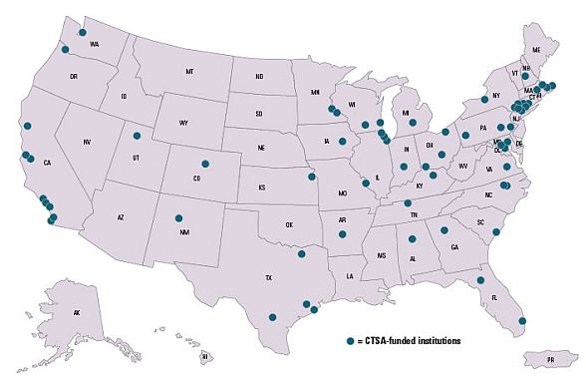

Slide 5
CTSA Program: Purpose
To develop innovative solutions that will improve the efficiency, quality and impact of the process for turning observations in the laboratory, clinic and community into interventions that improve the health of individuals” and populations at large*
To provide added value to interconnect, enrich advance, foster cross talk and weave together the tapestry of diverse scientific disciplines and medicine to solve complex problems in human health
* NCATS definition

Slide 6
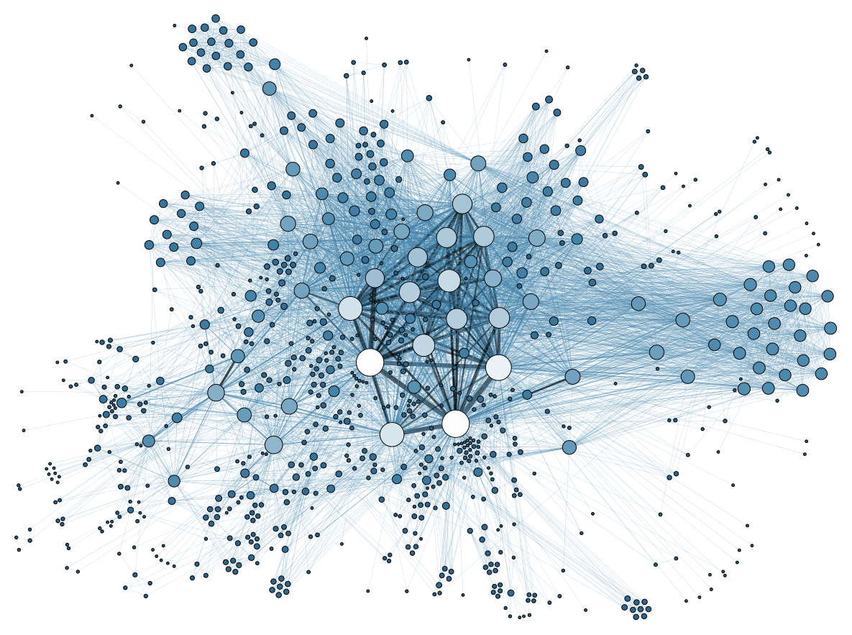
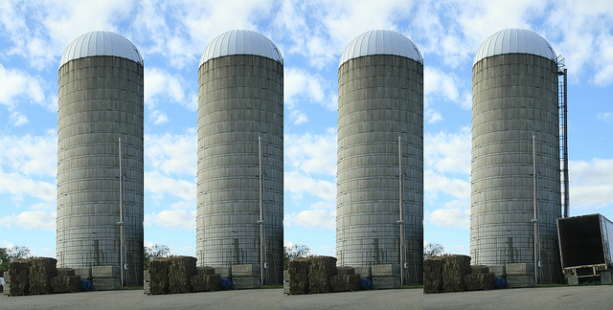
CTSA Purpose
To reengineer & transform the research enterprise
Move from a Siloed to a Systems Biology/Social Network structure
to

Slide 7
CTSA Program
Establish novel initiatives which focus on efforts that are essential to accelerate basic research discoveries and speed translation of these discoveries into clinical practice as well as explicitly address roadblocks that slow the pace of medical research in improving the health and well being of society

Slide 8

CTSA Key Research Elements
Translational
Innovation
Transdisciplinary
Communities of Practice (CoP)
Team Science

Slide 9
Innovation
Definition:
The process of translating an idea or invention into a good or service(s) that creates value for others and satisfies a specific need
The deliberate application of information, imagination, or initiative in deriving different values from resources & includes a processes by which new ideas are generated and converted into useful products, tools, applications

Slide 10
Types of Innovation*
Evolutionary
Continuous or dynamic evolutionary innovation that are brought about by meaningful incremental advances in technology or processes
Revolutionary
Also called discontinuous, which are also disruptive and new
* Taken from the Business dictionary

Slide 11

Revolutionary Innovation

Slide 12


Slide 13
CTSA
What is it?
Purpose/Intent
Why & How did they come to be?
ConduITS: CTSA at ISMMS
Impact

Slide 14

Harnessing Data in the Information Age

Slide 15


Landscape of Biomedical Science From Solitary to Team Framework

Slide 16
Origin of the CTSA
NIH Directors Panel of Experts: POR
Recommendations
1995
K30, Mentored K23, Health Services KO8, KO7, K24
NCI LLM PRG
2000/2001
C-TRAC
NIH RoadMap
2004
RoadMap T32 * K12
2005
CTSA Version 1 NCRR
KL2 & TL1 Programs
2006
CTSA Version 2
NCAT
2012
CTSA Version 3
Current RFA

Slide 17
Cancer Translational Research Allied Consortium (C-TRAC)
Shorten drug development from 5-10 yrs to 2 yrs
Comprised of nationally designated centers for translational cancer research that are affiliated with academic institutions
C-TRAC centers will fulfill well defined criteria and compete for designation

Slide 18
C-TRAC: a precursor for CTSA Blueprint
Governed by National Leadership Group & Board
Proposed Responsibilities:
Drug discovery, validation & Identification of lead compounds
Biomarker discovery
Preparing clinical grade reagents & Conducting phase I/II
Managing intellectual property and tech transfer issues
Developing sustainable models for career paths in translational investigation
Providing training & mentorship for development of new translational investigators
Developing and maintaining cores to support the myriad needs of translational researchers

Slide 19
Origin of the CTSA
NIH Directors Panel of Experts: POR
Recommendations
1995
K30, Mentored K23, Health Services KO8, KO7, K24
NCI LLM PRG
2000/2001
C-TRAC
NIH RoadMap
2004
RoadMap T32 * K12
2005
CTSA Version 1 NCRR
KL2 & TL1 Programs
2006
CTSA Version 2
NCAT
2012
CTSA Version 3
Current RFA

Slide 20
NIH RoadMap
Transform the way Biomedical Research is conducted
High Risk/High Reward
Enable the development of transformative tools & methodologies
Address fundamental knowledge gaps
Not possible by one NIH Institute alone
Change academic culture to foster collaboration & team science

Slide 21
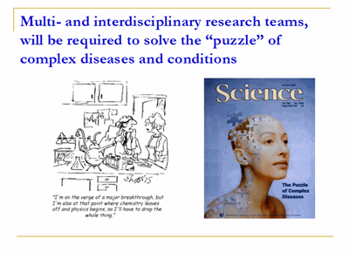

Slide 22
Three Themes
New Pathways to Discovery
Clinical Research Enterprise
Research Teams of the Future
Transdisciplinary

Slide 23
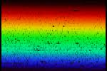
Spectrum of Collaborative Research
Disciplinary
Multidisciplinary
Interdisciplinary
Transdisciplinary

Slide 24
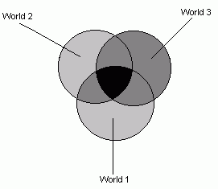
Multidisciplinary
Research in which different fields of expertise are brought to bear on a given question without integration
Research which brings a new angle or different perspective from varied unique disciplines
Disciplines investigating research themes using their own approaches
Retention of disciplinary autonomy

Slide 25
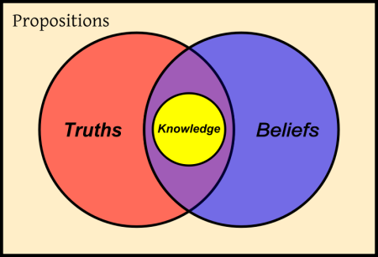
Interdisciplinary
A field of study that crosses traditional boundaries of academic disciplines or schools of thought
Common framework within which distinct epistemological approaches are utilized
Shared problem formulation

Slide 26
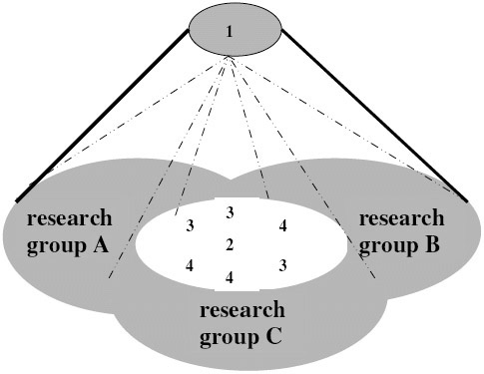
Transdisciplinary Research
Interpenetration, integration or fusion of disciplinary methodologies
Collaborative knowledge generation
Intentional involvement of stakeholders in the definition of the problem.
Engagement with spheres of practice

Slide 27
Transdisciplinary Research¹
Transcends well established and familiar boundaries of traditional disciplines
Complementary to ongoing discipline focused research
Implies the invention of “new science” at the intersection of respective fields
“Theoretical, conceptual and methodological reorientation with respect to core concepts of participating disciplines”²
¹ Gray, B; Amer J Prev Med 2008; 35 (2S): S124-132
² McMichael J. EOLOSS Publishers Ltd, 2000

Slide 28
Examples of Transdisciplinary Research
Bioinformatics & Computational Biology -
Ethnography
Systems Biology
Environmental Science
Social Media & Networking
Integrative Medicine
Global Health
Personalized Medicine

Slide 29
Examples of Transdisciplinary Research
Bioinformatics & Computational Biology -
Ethnography
Systems Biology
Environmental Science
Social Media & Networking
Integrative Medicine
Global Health
Personalized Medicine

Slide 30
Funding for the RoadMap Initiatives
NIH Institutes & Centers contributed to a common pool of resources and a plan as to how these resources would be utilized
Administered centrally
implemented by Working Groups composed of staff from multiple NIH Institutes or Centers
Institutionalized a corporate process for decision-making about priorities that span the breadth of the NIH .
NIH Reform Act (2006) provided continued support for Roadmap programs through the NIH Common Fund

Slide 31
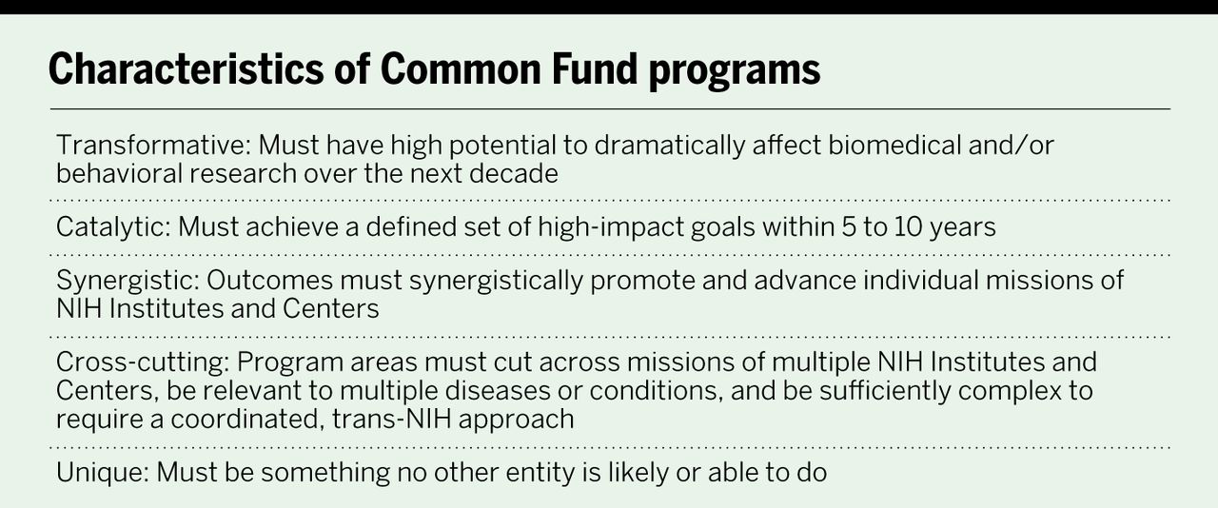

Slide 32
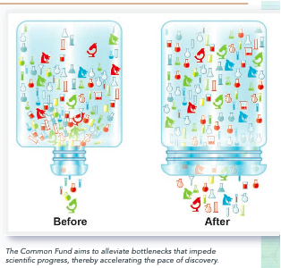

Slide 33
Origin of the CTSA
NIH Directors Panel of Experts: POR
Recommendations
1995
K30, Mentored K23, Health Services KO8, KO7, K24
NCI LLM PRG
2000/2001
C-TRAC
NIH RoadMap
2004
RoadMap T32 * K12
2005
CTSA Version 1 NCRR
KL2 & TL1 Programs
2006
CTSA Version 2
NCAT
2012
CTSA Version 3
Current RFA

Slide 34
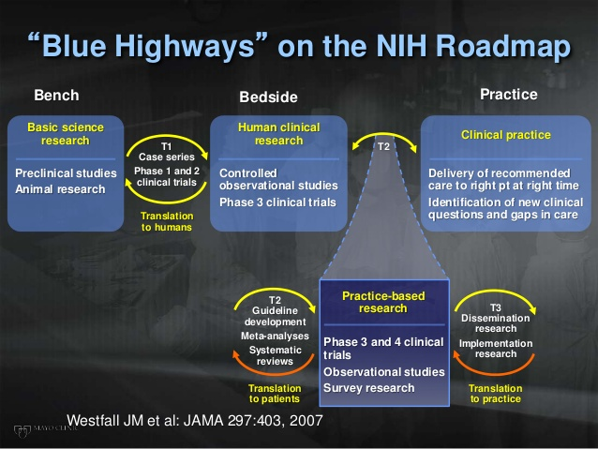

Slide 35
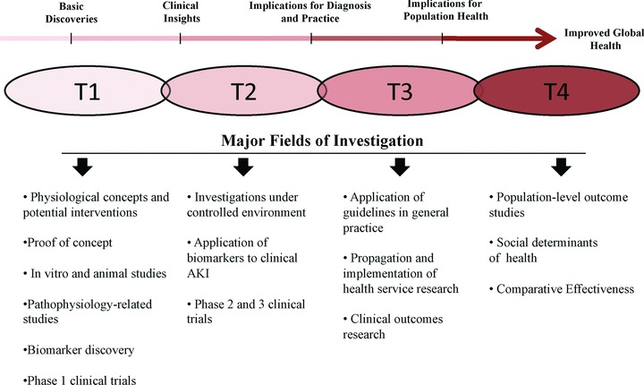

Slide 36
Transdisciplinary C/T Investigator: Characteristics & Skill Set
Critical Thinking
Ability to think outside the box
Openess to New Ideas, Technologies & Approaches
Imaginative
Adept at language: multi-lingual
Acquisition of new vocabulary
Ability to move outside comfort zone
Expertise in specific domain & “Informed Consumer” in other arenas

Slide 37


Slide 38
Challenges¹
Operationalizing cross disciplinary team science and training more clearly
Conceptualizing the multiple dimensions of readiness for team science
Ensuring sustainability of transdisciplinary team science
Creating and validating improved models, methods & measures for evaluating team science
Fostering a culture that values, promotes and rewards equitable research contributions and collective leadership/authorship
¹ Hall, KL et al, Am J Prev Med 2008; 35 (2S) S243-249

Slide 39
The Basic and Clinical Science Cultural Divide
Basic Science
Never arrive before 10
Devise experiments to test hypotheses
Theoretical knowledge
Contemplating data
Duplication of Data
Operating system X
Unit of measure: RO1
Quantitative measures
Clinical Science
Early risers
Informed by experiments of nature
Practical knowledge
Acting on evidence
Unique cases: N of 1
Operating system Y
Unit of measure: RVU
Qualitative measures

Slide 40
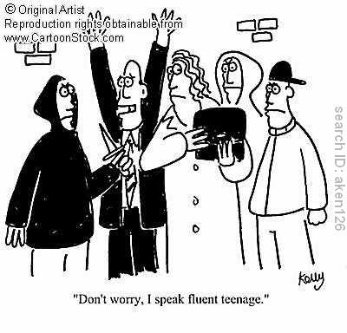

Slide 41
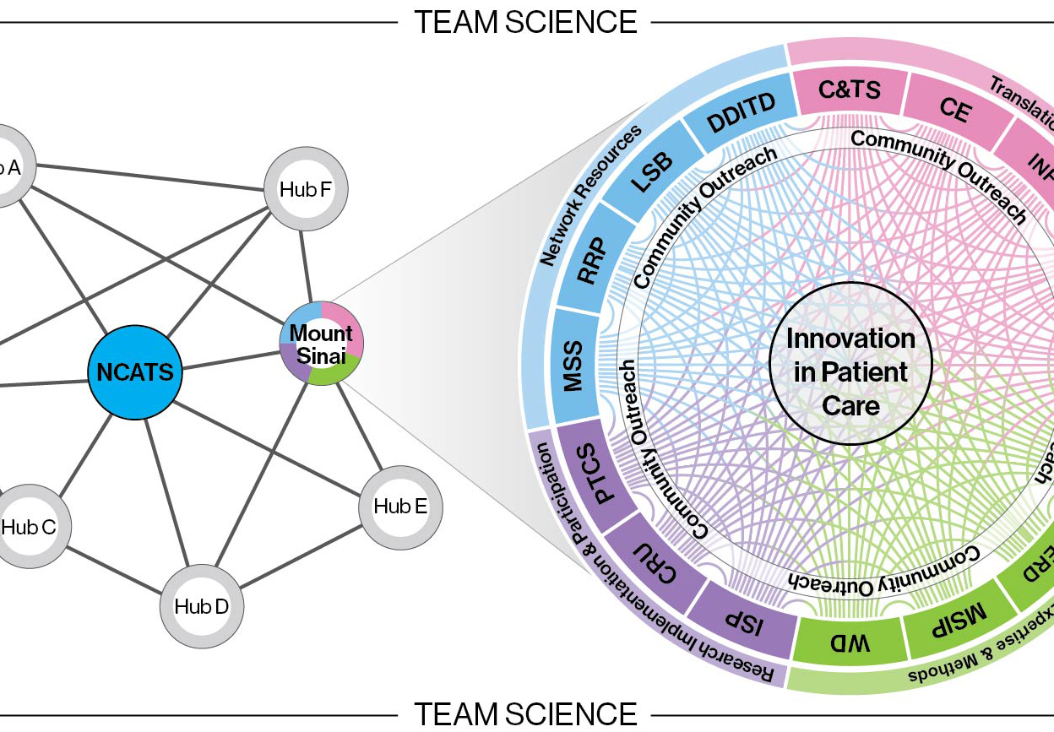

Slide 42
ConduITS: Institute for Translational Sciences
Key Principles
Key Elements*
Transformative
Catalytic
Additive & Synergistic
Cross Cutting
Unique
Added Value
Informatics
Query tools: I2B2
Workforce Development
Mentored CTS Training
Research Expertise, Methods & Processes
BERD
Community Engagement
Investigation across the Lifespan
*resources & platforms

Slide 43

Clinical & Translational Science (CTS) Education: Goals
Mentored To Independent Training Initiatives:
NRSA TL1 New Entry PORTAL (pre-doc) and STTEP-UP Training in Science and Medicine Initiative (post-doc)
KL2 Scholars
Emerging Investigators Forum(s)
Specialized Training Opportunities & Resources
Create or further extend and enrich specific mentored training opportunities for emerging pre-doctoral, post-doctoral and junior faculty CT Investigators, by means of:
Expanded novel offerings in our Clinical & Translational Science Education degree granting program

Slide 44
Mentored to Independent Investigator
Early Training Award recipients: F31/ F31 Equivalent Awards (pre-doctoral) NRSA TL1, T32
Mentored Award Recipients: F32, T32, K & K Equivalent
Independent: R or R equivalent:
K24 Midcareer Mentor Award

Slide 45
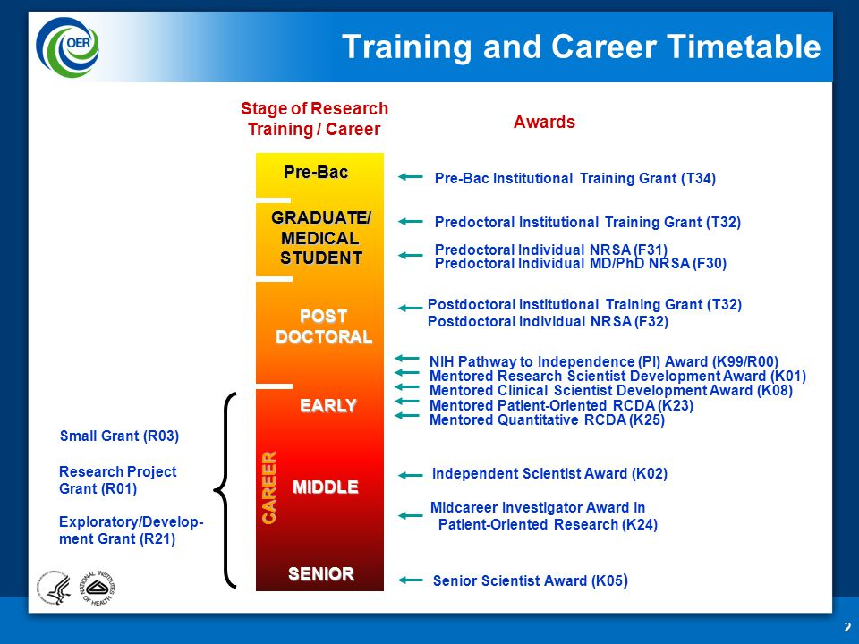

Slide 46
Funding*
* Owens B. Mapping Biomedical Research in the USA. Lancet 2014; 384:11- 14

Slide 47
Federal Funding
NIH
currently > 30 Billion
300,000 researchers, 2500 universities, 6000 intramural investigators (10%)
27 Institutes
NCI largest portion: 5 billion
Fogarty International Center (reducing disparities in global health): 65 million
National Center for Advancing Translational Sciences (NCATS) newest (2011)
Centers for Disease Control (CDC) – 6.6 billion
Veterans Affairs (VA) Office of Research & Development: 1.2 billion
Health issues related to veterans (mental health, post traumatic stress, prosthetics, brain and spinal cord injury)
National Science Foundation (NSF): 7 Billion
Department of Defense (DoD): ).5 billion
NASA’s Human Research Program: 150 million
US Department of Agriculture
Department of Energy (DoE): 300 million (5 billion budget) on biological systems
Home of the human genome project
2/3 of budget goes to genomic research
Joint Genome Institute (JGI)
*Owens B. Mapping Biomedical Research in the USA. Lancet 2014; 384:11- 14

Slide 48
Non-Federal Funding*
State-specific
Private Foundations
Drug & Device Industry
Venture Capital
Angel Investor(s)
*Owens B. Mapping Biomedical Research in the USA. Lancet 2014; 384:11- 14

Slide 49
Other Funding
Loan Repayment Program
https://www.lrp.nih.gov/
Diversity Supplements
https://www.nimhd.nih.gov/programs/extramural/training-career-dev/research-supplements/diversity-supplements.html

Slide 51
Office of Research Infrastructure Programs (ORIP) Strategic Plan
High priority trans NIH thematic areas are:
Developing models of human diseases.
Accelerating research discoveries by providing accessto state-of-the-art instrumentation.
Training and diversifying the biomedical workforce.

Slide 52
Management Essentials for the Emerging/Early Investigator*
Mentorship
Scientific Career Development
CATs toolkit (resources and support for investigators); IDP, Mentorship & being effective mentee; time management & prioritization; presentation skills; communicating with program officers; RCR; research ethics; communication in science
Grant Writing, grant management & principals of project management
Funding sources, agencies & opportunities; writing specific aims; career development awards; budgets and budget justification; understanding NIH peer review; pre-award and post award management
Leadership
Leading from self; understanding conflict; negotiation essentials: asking for what you need; collaboration essentials & teaming
* Adapted from Byington et al, Acad Med 2016

Slide 53
Matrix Mentoring Model*
Self
Senior
Scientific
Staff
Peer/Near Peer
Byington CL et al. Acad Med. 2016;91:497–502.

Slide 54
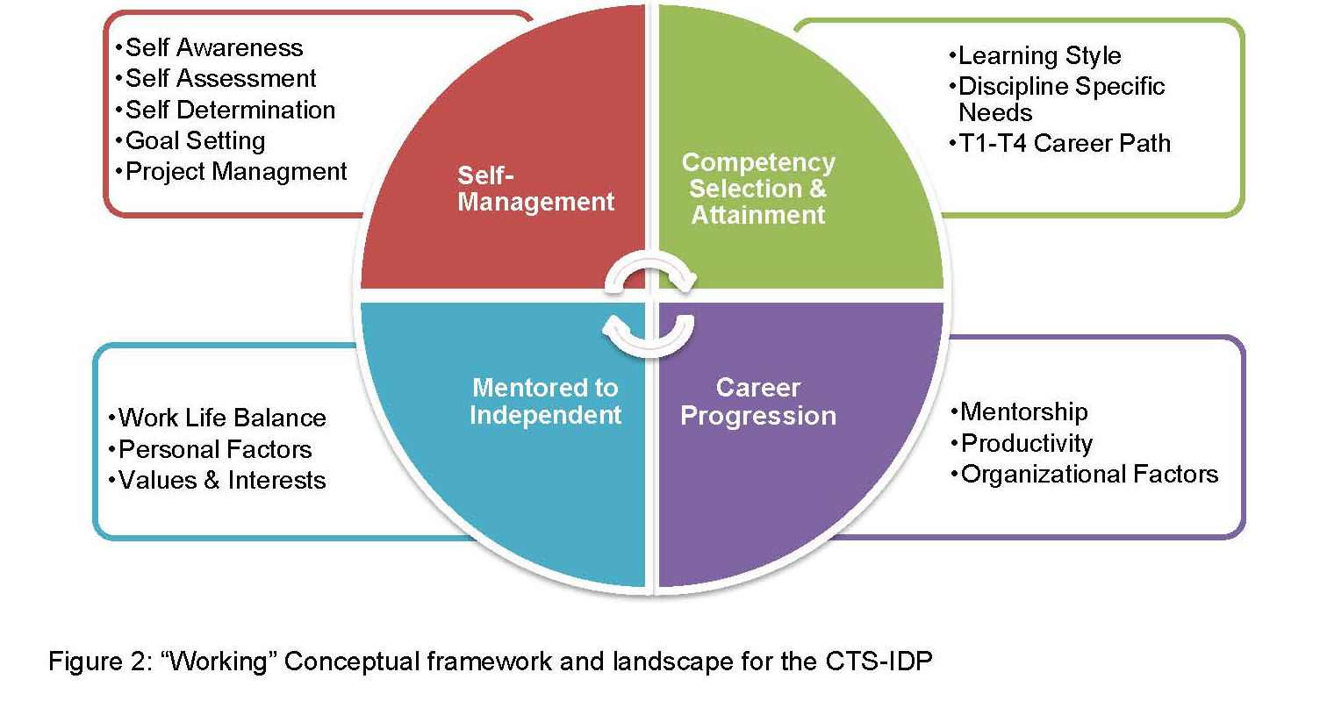
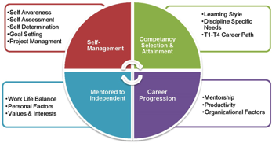
IDP: Guiding Mentee Career Development*
* Martina CA, Gabrilove J, Luban N, Patino-Sutton C. JCTS 2018;1, S1: 2502

Slide 55
Institutional Resources to Support Research
Center for Biostatistics & BERD
GARC (grant application resource center)
IRB
ORS
IND & IDE consultation; Research Match; recrutiemtn methods; ClinicalTrials.gov
Sinai APPLab
Sinai Biodesign
Research Portal
SPIN: funding opportuntities
Grants application resource center
Protocol wizard to guide protocol requirements
PEAK – IDEATE & Infoed Training; other training modules of relevance to research
RedCap including survey building & eCRFs
Research IT
IDEATE – Ideate@mssm.edu ; ideate support – Jean Davis administrator

Slide 56
New WEbsites
http://researchroadmap.mssm.edu/rrm/
http://labs.icahn.mssm.edu/earlyinvestigators/

